Slide 1




AI FARMER ASSISTANT
Abdulaziz Ashehri

Slide 2



Problem statement
Farmers struggle to identify plant diseases or get fast access to farming knowledge

Slide 3


Project Objective
Develop an AI assistant for early plant disease detection and interactive knowledge access.

Slide 4








OVERVIEW
LangChain
Agent
Multimodal input
Image
Classifier
RAG
Gradio

Slide 5





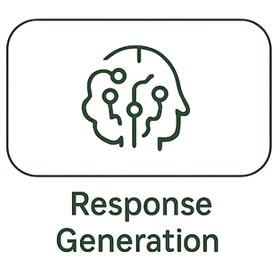





Zara’a pipeline
image
Langchain Agent
Text
Chroma

Slide 6

Evaluation via Langsmith
Latency
2.3
35.4
Tokens avr
544
Total cost
0.07$

Slide 7

Future Enhancements
Soil Analysis
Weather-based irrigation
Cloud deployment

Slide 8

Zara’a ai assistant
Deployment

Slide 9

Thank You!

